Slide 1


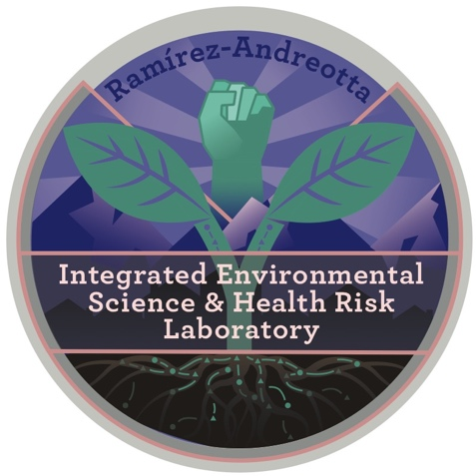
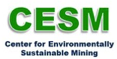


Community Monitoring of Arsenic and Lead in Residential Properties Neighboring Mining Operations
Nicole Van Overmeiren
Arizona Space Grant Symposium
April 17, 2020

Slide 2
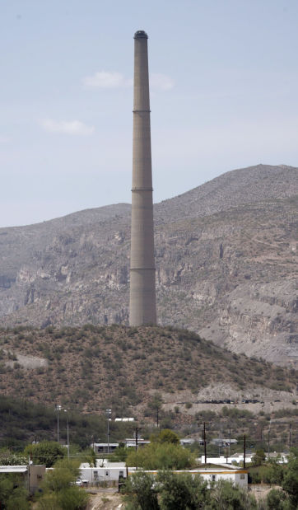
Background
Mining towns are threatened by contamination from mining activities.
Elevated arsenic and lead in soil, water, and airborne dust.¹
Criteria contaminants due to the negative health outcomes associated with exposure.
Residents involved in this research are concerned about the environmental impact that mining activity has had on their town.
2018: Community reached out to our research group.
July 27, 2019: Sample collection training conducted in the community by UA researchers and faculty.
August 24, 2019: Samples collected.
Example of smelter. From Asarco operation in Hayden, Arizona circa 2007. Courtesy of Arizona Daily Star.
¹Agency for Toxic Substances and Disease Registry. “Asarco Hayden Exposure Investigation.” Centers for Disease Control and Prevention, 7 Jan. 2020, www.atsdr.cdc.gov/sites/hwaz/overview.html.

Slide 3
Objectives
Use a citizen science design to conduct an environmental monitoring project.
Assess arsenic and lead concentration in soil, dust, and drinking water from residential properties.
Compare arsenic and lead concentration to:
Federal government standards and action levels
Arizona Soil Remediation Levels and Standards
Soil background concentrations (AZ and U.S.)

Slide 4
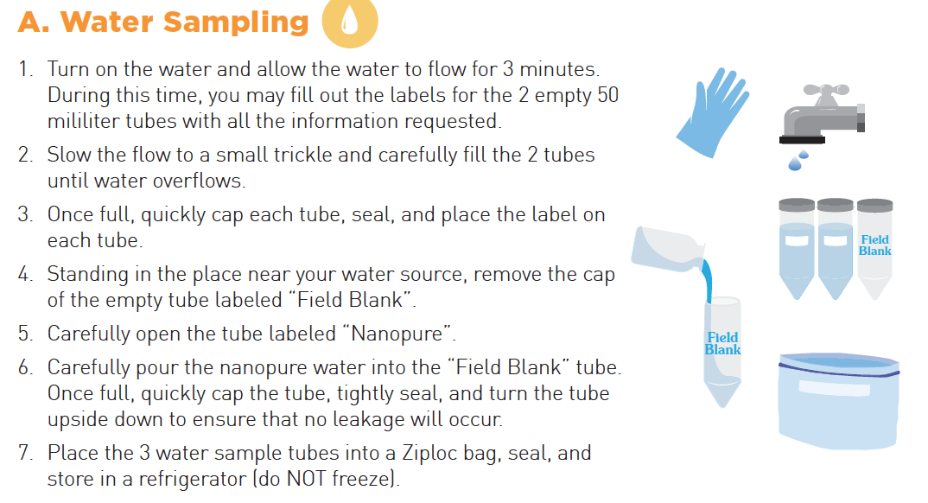
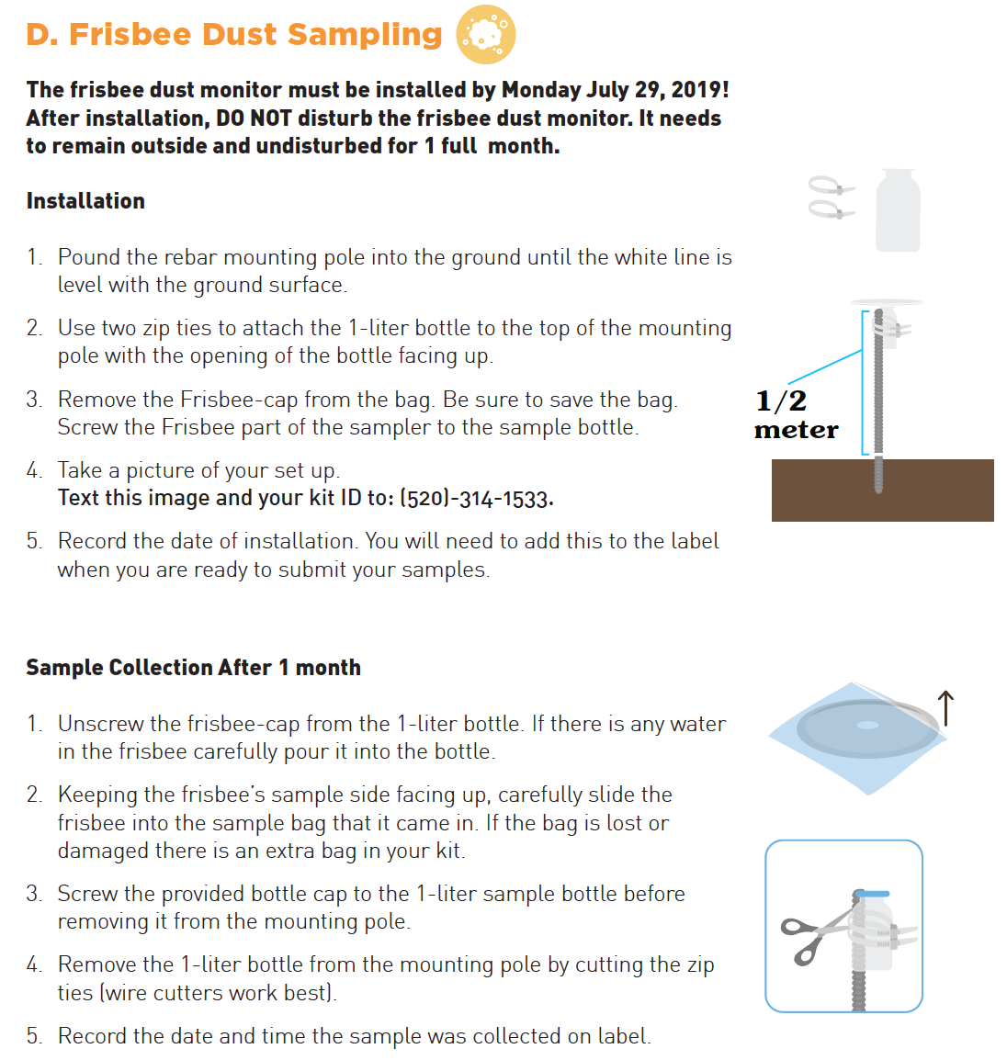
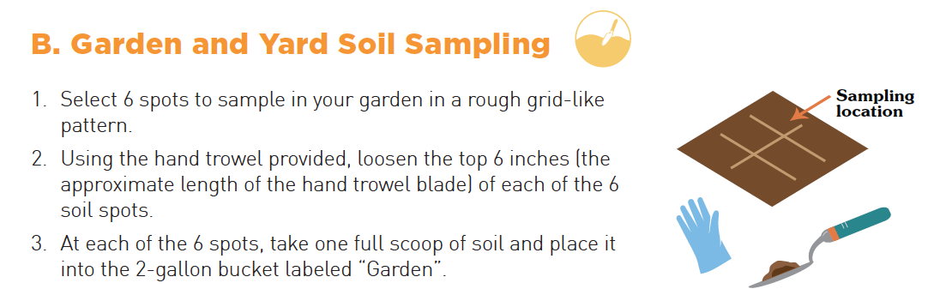
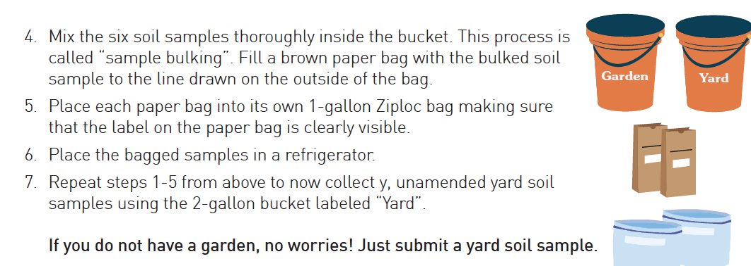
Experimental Design: Sample Collection

Slide 5
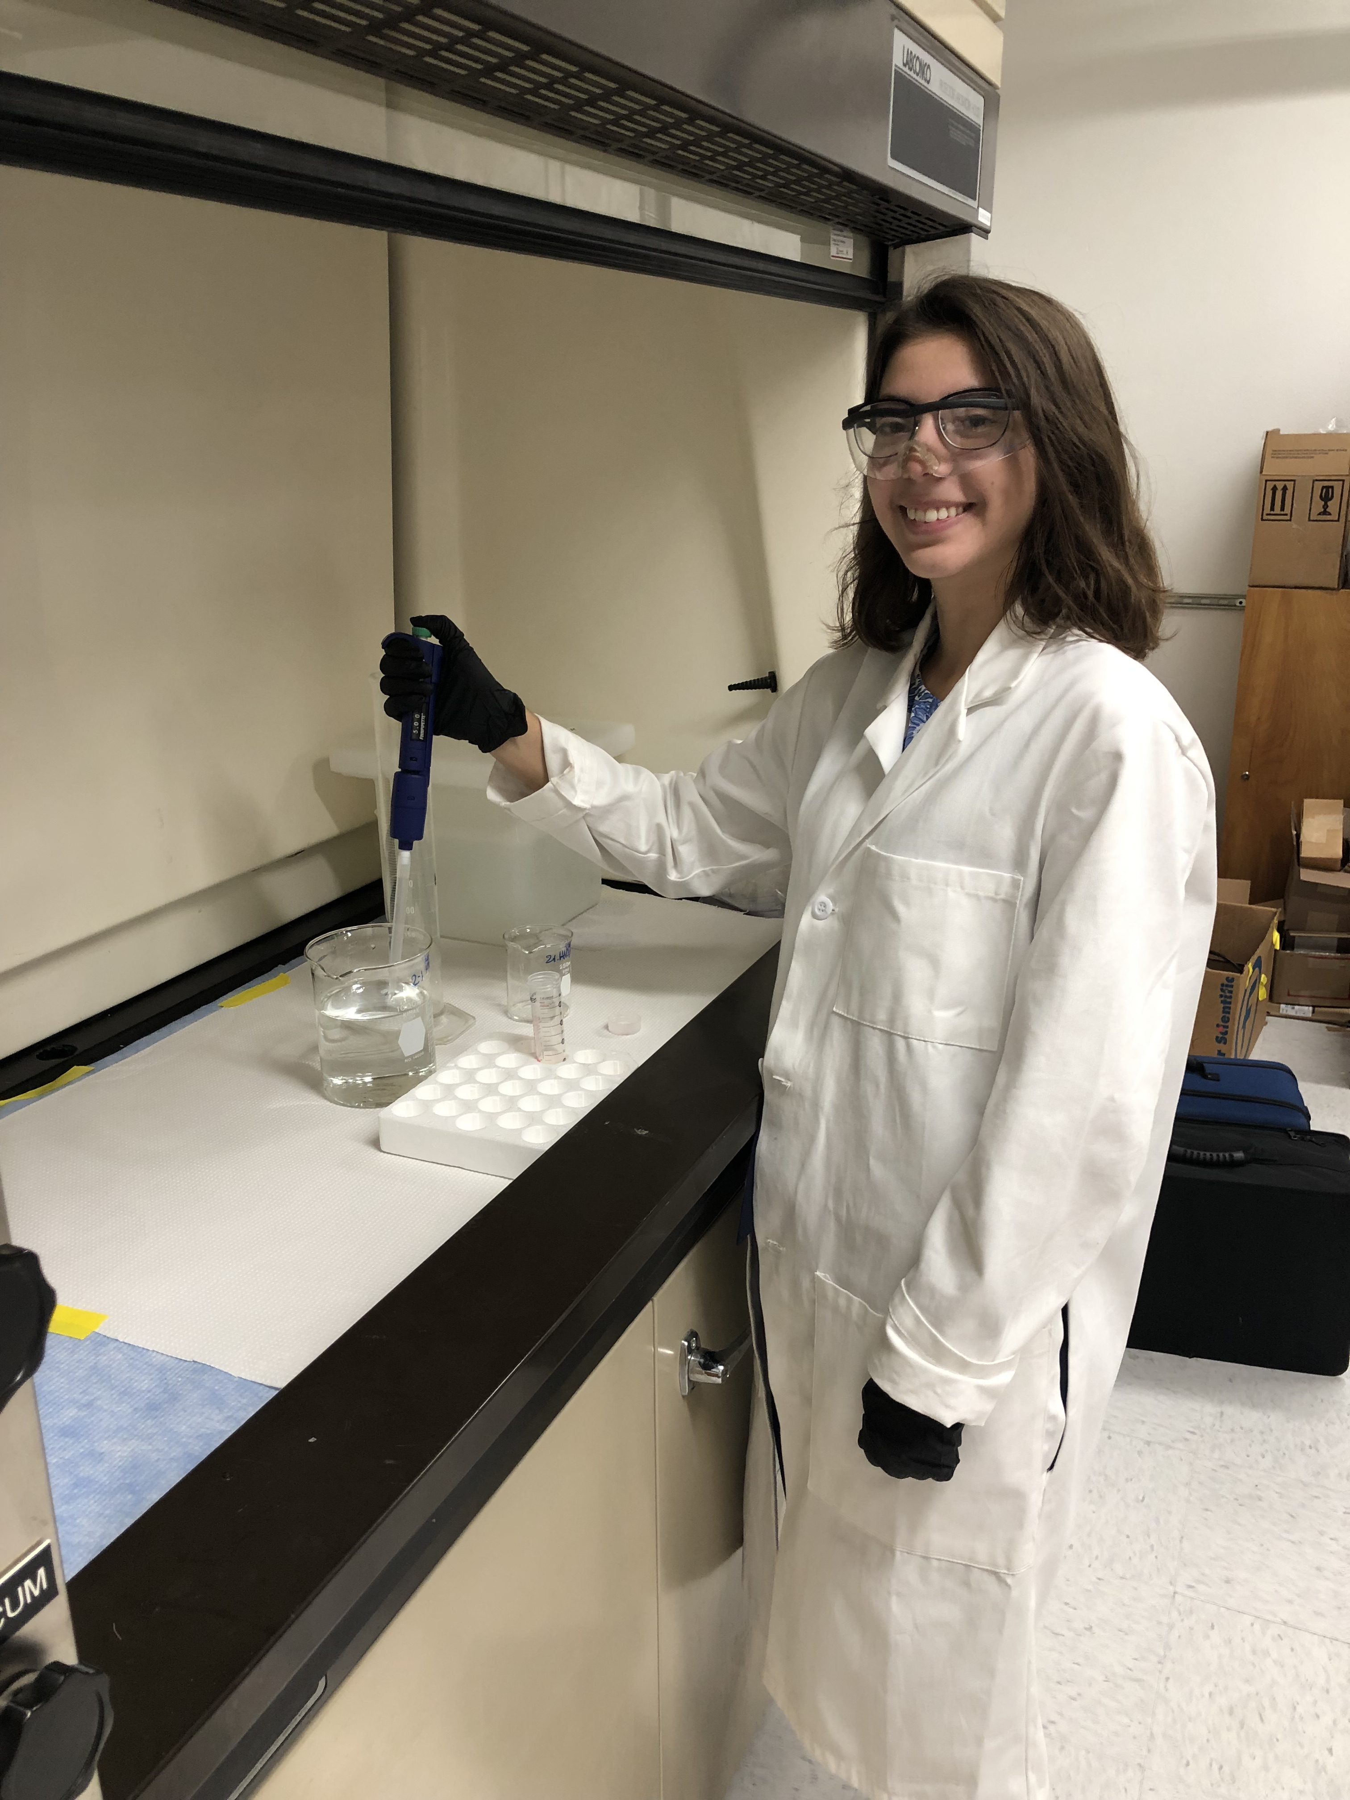
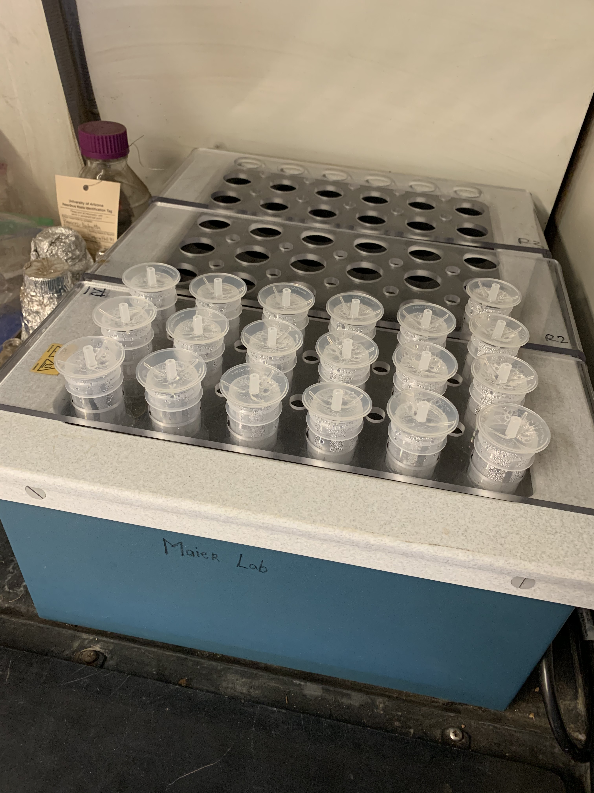
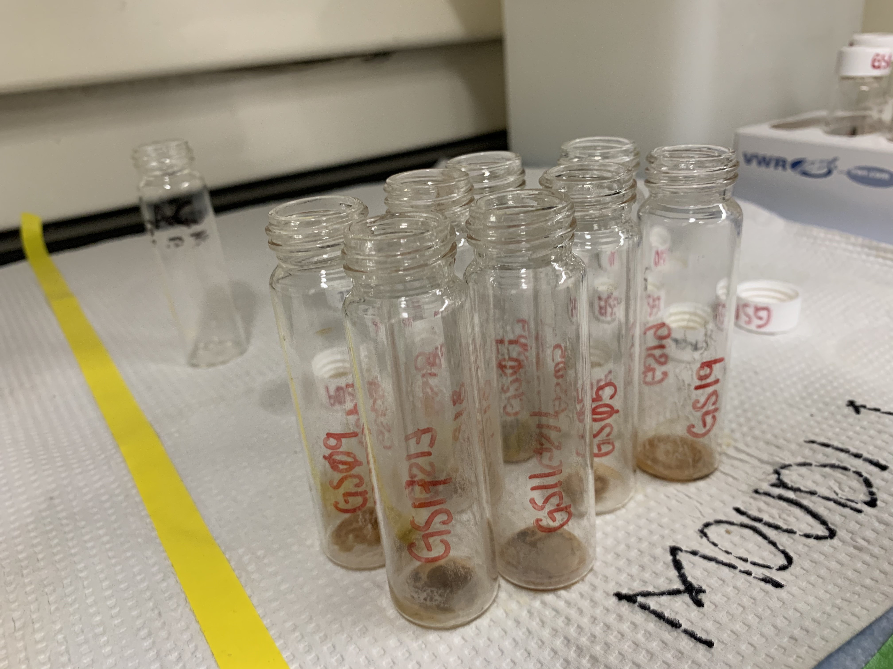
Experimental Design: Sample Processing
Dust, soil, and water samples were processed by our lab group.
Upon processing, all samples were sent to Arizona Laboratory for Emerging Contaminants for trace metal analysis by inductively-coupled plasma mass spectrometry (ICP-MS).

Slide 6
Results

Slide 7
Garden and Yard Soil Samples
Note on Lead: The mean background soil value of lead in Arizona soil is 21.4 ppm.² All samples exceeded this level.
Note on Arsenic: The background concentrations of arsenic in US soils range from 1 to 40 ppm, with mean values around 5 ppm.³ All sites exceeded the mean level. Sites closest to the mine tailings exhibited levels far outside of natural range.
ADEQ Lead Soil Remediation Level⁴ = 400 ppm
ADEQ Arsenic Soil Remediation Level⁴ = 10 ppm
² USGS Background Soil-Lead Survey: State Data Geogenic Soil Lead Concentrations (mg/kg): 2007-2010 (Outliers Excluded) https://www.epa.gov/superfund/usgs-background-soil-lead-survey-state-data#AZ
³ Environmental Health Criteria 224: Arsenic and Arsenic Compounds by United Nations Environment Programme, the International Labour Organization, and the World Health Organization, 2001. http://www.inchem.org/documents/ehc/ehc/ehc224.htm#4.1.4
⁴ Arizona Department of Environmental Quality (ADEQ) Soil Remediation Level (SRL): A residential-yard soil screening-level based on a health risk-assessment. If a metal concentration in a residential yard soil is above the level, it suggests further investigation should be taken, but does not necessarily require cleanup. Taken from the Arizona Administrative Code, Department of Environmental Quality – Remedial Action. Title 18. Environmental Quality Chapter 7. Department Of Environmental Quality Remedial Action. Last updated on March 31, 2009. https://apps.azsos.gov/public_services/Title_18/18-07.pdf

Slide 8
Dust Samples
HUD Dust-Lead Porch Clearance Level⁵ = 40 µg/ft²
⁵ Department of Housing and Urban Development (HUD) Dust-Lead Porch Clearance Action Level: An outdoor porch dust clearance level based on a health risk-assessment. Recommended maximum concentration before action must be taken to abate the amount of lead. https://www.hud.gov/sites/documents/LEADDUSTCLEARANCE.PDF

Slide 9
Drinking Water Samples
Note on Arsenic: Sample taken from surface body of water had an arsenic concentration of 45 µg/L, which exceeded EPA arsenic standard for drinking water and ADEQ full body-contact.⁶
EPA Lead Maximum Contaminant Level⁷ = 15 µg/L
EPA Arsenic Maximum Contaminant Level⁷ = 10 µg/L
⁶ The Arizona Administrative Code. December 31, 2016. Title 18. Environmental Quality Chapter 11. Department of Environmental Quality - Water Quality Standards. https://apps.azsos.gov/public_services/ Title_18/18-11.pdf
⁷ Environmental Protection Agency (EPA) Maximum Contaminant Levels (MCL): The maximum amount of a contaminant allowed in drinking water so that it is still safe to use over the long-term. This level is set and legally enforced by the US Environmental Protection Agency. Also referred to Primary Drinking Water Standard. Taken from the US EPA. National Primary Drinking Water Regulations. Last updated on March 22, 2018. https://www.epa.gov/ground-water-and-drinking-water/national-primary-drinking-water-regulations

Slide 10
Interpretation of Results

Slide 11
Error Mitigation
Type of Error | Corrective Measures
Small sample size | Sample size is representative of voluntary participation
Inconsistencies in sample collection | Participants trained by UA faculty Field blanks collected for quality control
Human error | Use of trace metal-free labware to minimize outside contamination

Slide 12
Conclusions
Citizen science design was effective.
19 out of 21 participants submitted samples.
Soil samples were noteworthy, indicating that nearby mining activity may have impacted these sites.
Soil samples exceeded:
U.S. mean background arsenic concentrations
Arizona state mean background lead concentrations
16/18 samples exceeded Arizona Soil Remediation Level (SRL) for arsenic.
Highest concentration at the site closest to mining activity.
Single sample that exceeded SRL for lead must be further investigated.

Slide 13
Next Steps
This study reveals that the environmental health impact of mining activity on nearby residential communities warrants further investigation.
Data will be compared to that of other mining communities in Arizona.
Data-sharing event will be held to inform participants of their results.

Slide 14

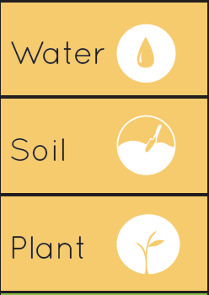
Thank you very much!
Principal Investigator:
Dr. Monica Ramirez-Andreotta
Lab Members:
Nicole Van Overmeiren
Kunal Palawat
Diego Huerta
Kyle Rine
Tania Rodriguez
https://gardenroots.arizona.edu/

